Slide 1

CCE 313 – Computer Networks: IP Subnetting
Presented By: Nazmus Sakib
Student ID: 2102066
Reg: 10193
B.Sc. CSE – 5th Semester
Date: 24/11/2025

Slide 2

Introduction to IP Subnetting
Introduction
IP Subnetting is the strategic division of a large network into smaller, more manageable logical networks. This process is fundamental for the efficient organisation and allocation of IP addresses within any robust network infrastructure.
It serves as a critical tool for network administrators to optimize network performance and resource utilization.

Slide 3

Problem Statement
Without proper subnetting, large networks are prone to
several critical issues:
Importance
Implementing IP subnetting profoundly enhances
network performance, significantly reducing broadcast traffic and bolstering security segmentation across the network. This results in a more stable, secure, and efficient operating environment.
Broadcast storms: Excessive broadcast traffic can
overwhelm network devices.
IP wastage: Inefficient allocation leads to unused IP addresses.
Congestion: Unnecessary traffic causes network slowdowns.
Lack of security segmentation: Difficulty in isolating
vulnerable sections.
IP Subnetting is used to split a large network into smaller logical sub-networks. Without subnetting, large networks face broadcast storms, inefficient IP usage, congestion, and weak security separation. Subnetting helps optimise performance and ensures better management of IP addresses.

Slide 4

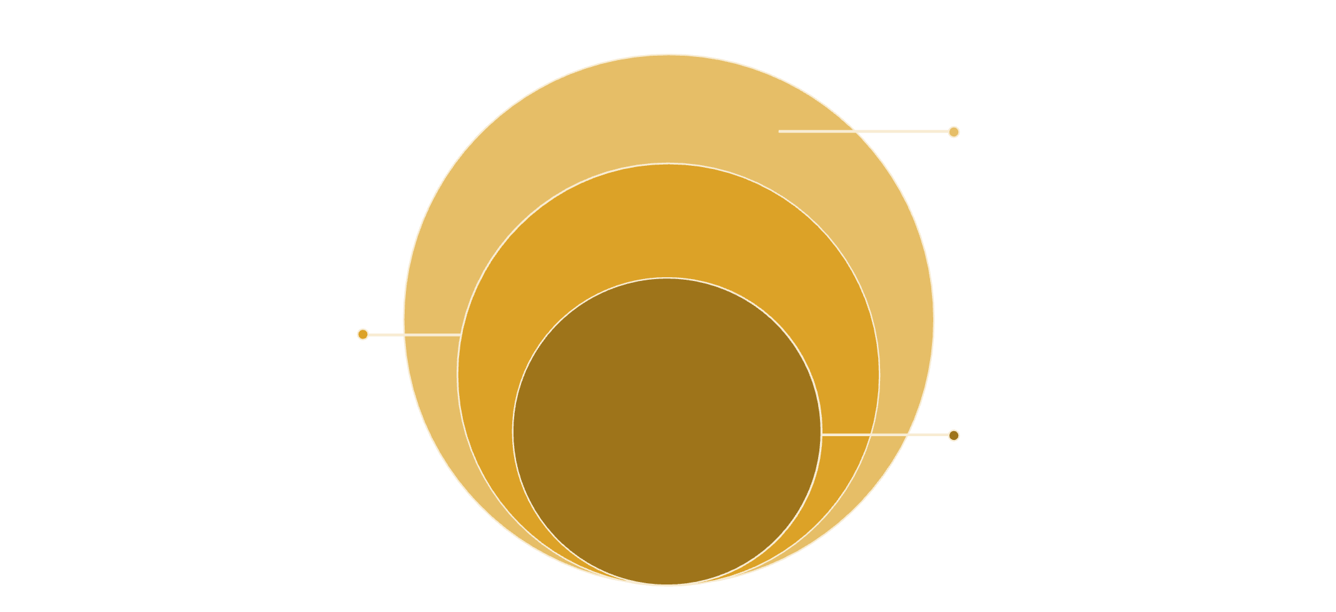
IP Address Structure & Subnet Mask
IPv4 Structure
Subnet Mask
An IPv4 address is a 32-bit numerical label assigned to devices connected to a computer network. It is conventionally represented in dot-decimal notation.
The subnet mask is a 32-bit number that distinguishes the network part of an IP address from the host part. It effectively determines how many bits are used for the network identification.
It comprises two main parts: a Network part and a Host part.
Examples:
Example: 192.168.10.5
255.255.255.0 (/24) – A common mask for smaller networks.
255.255.255.192 (/26) – A mask indicating more subnets.
255.255.255.252 (/30) – Often used for point-to-point links.
Host Bits
Specifies individual device addresses
Subnet Bits
Defines subnetwork segmentation and mask
Network Bits
Identifies the routing network portion

Slide 5
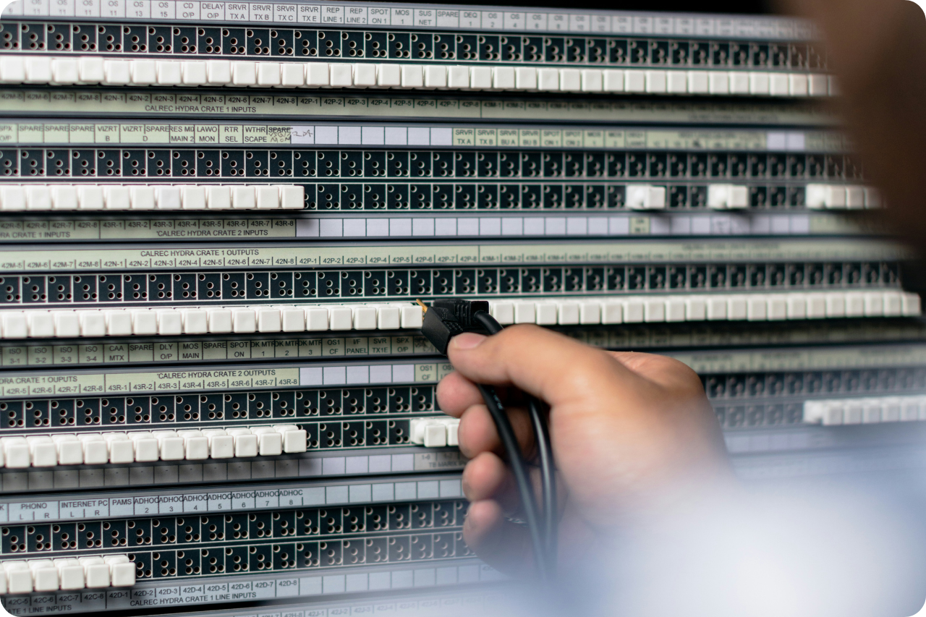
An IPv4 address has 32 bits divided into network and host portions. The subnet mask indicates how many bits belong to the network. For example, /24 uses 24 bits for the network. When we create subnets, we adjust this mask to allocate bits differently.

Slide 6







How Subnetting Works
Borrow Bits
Create Subnets
Apply Formulas
Subnetting fundamentally involves 'borrowing' bits from the host portion of an IP address. These borrowed bits are then used to create additional network addresses, effectively segmenting the larger network.
By borrowing bits, we create multiple, smaller, independent networks, known as subnets. Each subnet operates as its own broadcast domain, reducing overall network traffic and improving efficiency.
Specific formulas are used to calculate the number of subnets and the number of usable hosts within each subnet, ensuring precise network planning.
Number of Subnets
Hosts per Subnet
Calculated as 2ⁿ, where 'n' represents the number of borrowed bits from the host portion. This directly determines how many subnets can be created.
Determined by 2ʰ – 2, where 'h' is the number of remaining host bits. The subtraction of two accounts for the network address and the broadcast address, which are not assignable to hosts.

Slide 7

Example: Transitioning from /24 to
/26
By borrowing 2 bits from the host portion of a /24 network, we generate 4 distinct subnets.
This provides a granular control over network segmentation and IP allocation.
Subnetting works by borrowing bits from the host portion. If we borrow n bits, we get 2ⁿ subnets. If we have h remaining host bits, we get 2ʰ minus 2 usable hosts. For example, turning /24 into /26 involves borrowing 2 bits, which creates 4 equal-sized subnets.

Slide 8
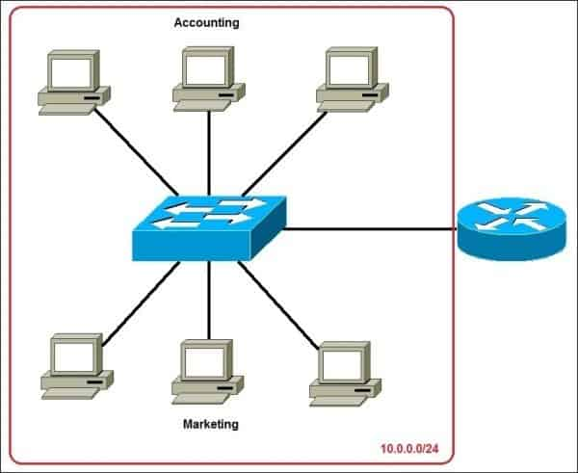
Subnetting Example (Worked Solution)
Given:
Step 2: Determine Subnet Ranges
192.168.10.0/24
Each subnet will have a block size of 64 addresses (2^(32-26) = 2^6 = 64). The ranges are as follows:
Required:
4 subnets
Step 1: Borrow Bits
192.168.10.0 – 192.168.10.63
192.168.10.64 – 192.168.10.127
To achieve 4 subnets, we need to borrow 2 bits (since 2² = 4). This changes the subnet mask from /24 to /26.
192.168.10.128 – 192.168.10.191
192.168.10.192 – 192.168.10.255
Each Subnet:
Usable hosts: 62 (64 total addresses - 2 for network/broadcast)
Broadcast address: Always the last address in each range.

Slide 9
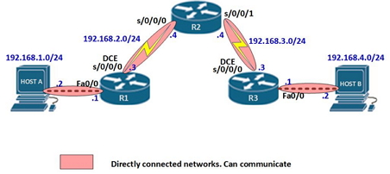
Here is a practical subnetting example. For the network 192.168.10.0/24, we need 4 subnets. By borrowing 2 bits we get a /26 mask. This gives us four subnets, each providing 62 usable host addresses. These ranges are clearly separated and help organise networks efficiently.

Slide 10







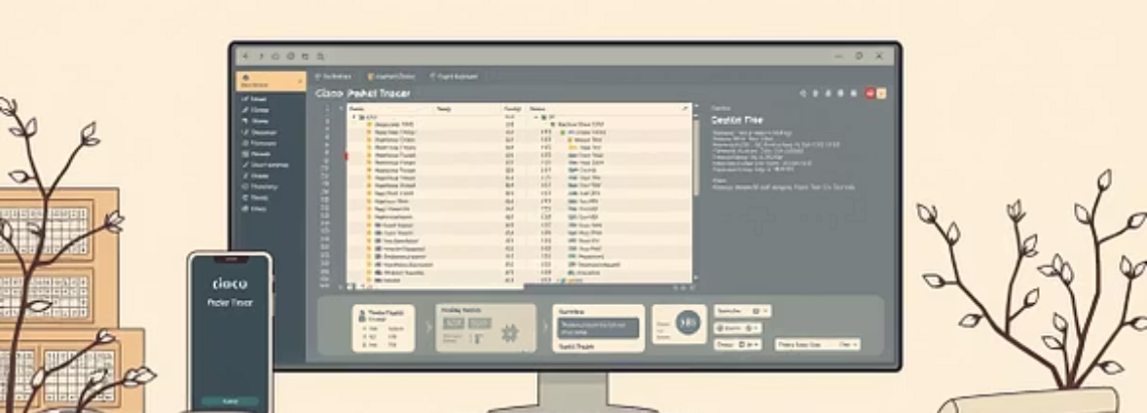
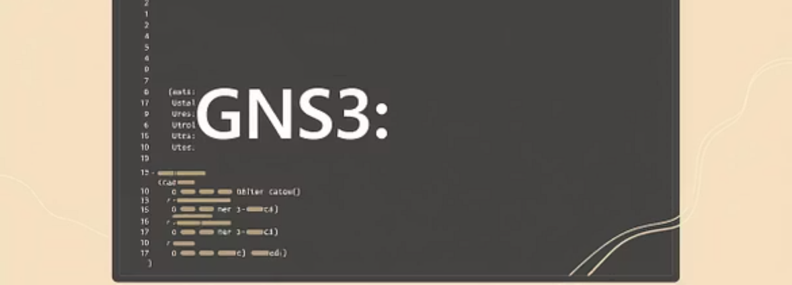
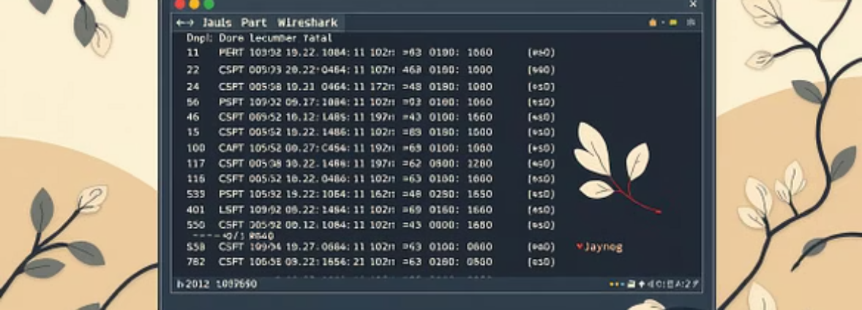
Analysis & Practical Implications
Large Organisations
Universities & Campus Networks
ISPs
Essential for segmenting departments and improving network security and performance.
Manages vast numbers of devices and users across different faculties and dormitories.
Crucial for allocating IP addresses to millions of customers efficiently and managing network traffic.
VLAN-based Networks
Routers and Routing Tables
Integrates seamlessly with VLANs to create logical broadcast domains, further enhancing network control.
Fundamental for routers to correctly forward packets between different subnets, maintaining efficient data flow.
Key Benefits of Subnetting
Efficient IP Address Usage
Smaller Broadcast Domains
Minimises wastage of valuable IP addresses, ensuring resources are optimally utilised.
Reduces network congestion and enhances performance by limiting the scope of broadcast traffic.
Improved Performance
Better Security Segmentation
Leads to faster network response times and greater overall operational efficiency.
Allows for the isolation of network segments, preventing security breaches from spreading across the entire network.

Slide 11
Thank
You

